Slide 1
Virginia Hospital Escapes
A comparison of the venues surrounding Virginia hospitals
Micah Gray
December 3, 2019

Slide 2
Labeling Hospitals According to Types of Surrounding Venues Could be Useful to Hospital Staff and Visitors
Hospital patrons and visitors appreciate having nearby alternatives to cafeteria food.
Hospitals with a park or garden path nearby offer patrons, staff, and visitors an avenue to get some precious fresh air and exercise.
Hospitals with convenience stores nearby offer patrons easy access to magazines, snacks, and other items of interest.

Slide 3
Data Sources and Cleaning
Hospital names, cities, and geocoordinates for 271 hospitals were obtained from http://www.lat-long.com/
Venue names, geocoordinates, type, and distance from the hospital for 23,867 venues were obtained from Foursquare.com
First dropped historical hospitals, resulting in 247 hospitals
Then filtered out psychiatric and mental hospitals, nursing homes, a dental clinic, and a veterinary hospital, resulting in 219 general hospitals
Dropped venues with missing, obscure, or irrelevant venue types, resulting in 19,956 venues belonging to 472 venue types

Slide 4
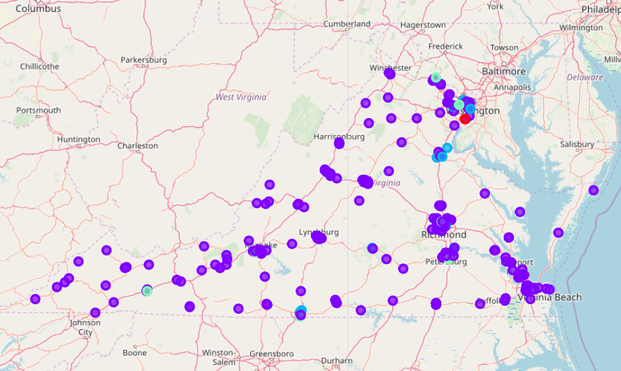
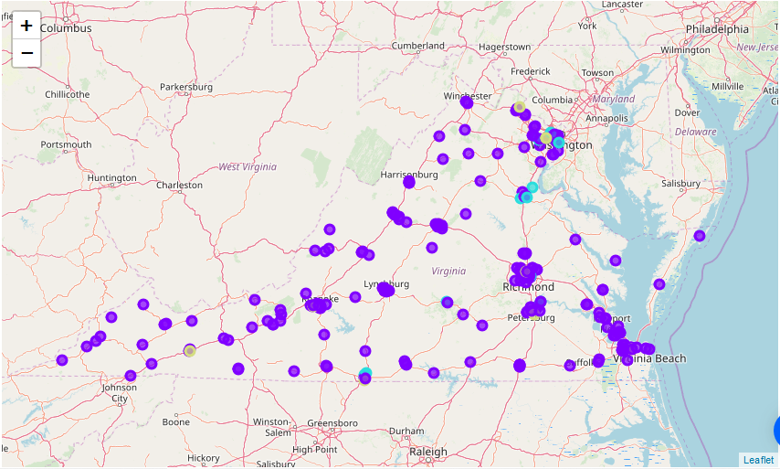
Exploratory Analysis - Plotting all 247 Hospitals by Type
Legend
Purple – General Hospital
Blue – Nursing Home
Lt. Blue – Psychiatric Hospital
Red - Dental Clinic

Slide 5
Reducing the Geographical Area
Hospitals in Virginia are very spread out, with most hospitals clustered around areas of dense population.
I redefined my area of interest to northern Virginia and set the following boundaries:
east_limit = -78.00000 longitude
west_limit = -76.80000 longitude
north_limit = 39.00000 latitude
south_limit = 38.50000 latitude
I also reduced the distance to venues to a 300 meter radius – easy walking distance
This left 24 hospitals and 194 venue categories in the northern Virginia dataset

Slide 6
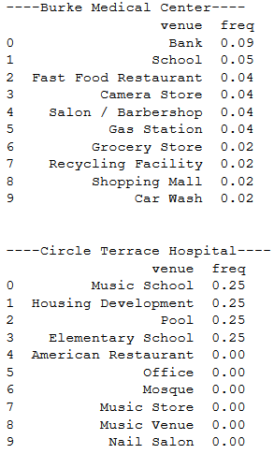
Top 10 Most Frequent Venue Types for Two Hospitals in Northern Virginia
Notice that Burke Medical Center has more than twice as many Banks as Fast Food Restaurants nearby, and that there are twice as many Fast Food Restaurants as Grocery Stores.
Circle Terrace Hospital has four types of venues nearby, with an equal number of each type.

Slide 7
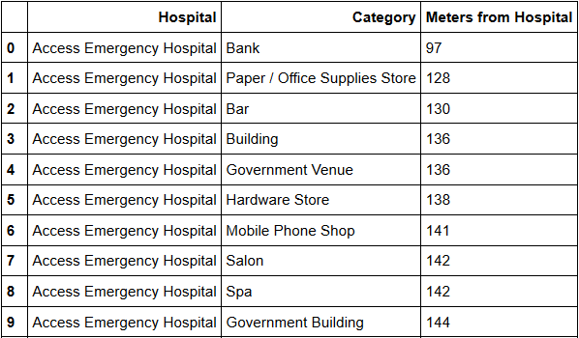
Exploratory Analysis – Comparing the closest venues by Category
The distance here represents the distance to the closest venue in the associated category. For example, the closest type of venue to Access Emergency Hospital is a Bank, and it is 97 meters away. The next closest venue type is a Paper / Office Supplies Store.

Slide 8
Clustering Hospitals based on frequency of venue type and on distance of nearest venue of each type, using K-Means.
Clusters Based on Frequency
Cluster ID | Number of Hospitals | Names of Clusters
0 | 16 | Mostly Office Buildings
1 | 1 | Food Court, Coffee Shop, Beer Garden
2 | 1 | Elem. School and Pool
3 | 1 | Entertainment and Playground
4 | 6 | Cafés and Buildings
Clusters Based on Distance Bin
Cluster ID | Number of Hospitals | Names of Clusters
0 | 2 | Variety Mid Dist
1 | 5 | Variety Farther Dist
2 | 1 | Variety and Leisure Close
3 | 14 | Pharm with Farther Variety
4 | 3 | Café, Pharm, and Med

Slide 9
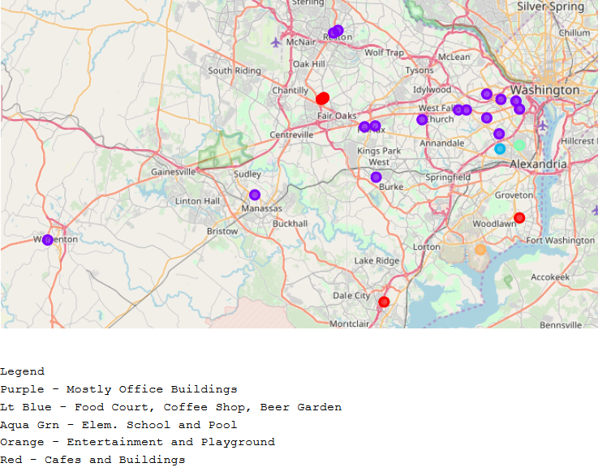
Results Plot –clusters based on frequency

Slide 10
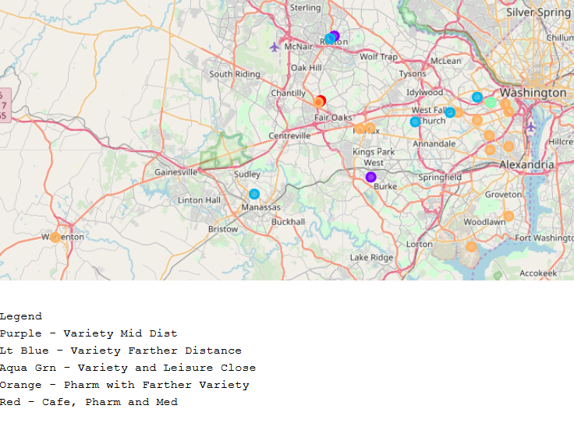
Results Plot - clusters based on distance

Slide 11
A New Approach
The two groups of clusters did not capture information helpful to hospital visitors or staff
This time, rather than use K-Means or another machine learning algorithm, I cluster the hospitals based on the venue types that I think are most valued. Too bad I’m not a SME!
I grouped all 218 general hospitals in Virginia based on the following venue types within 500 meters:
Pharmacy
Fast Food Restaurant
Sandwich Place
Pizza Place
Grocery Store
Burger Joint
Convenience Store
Organic Grocery
Park

Slide 12
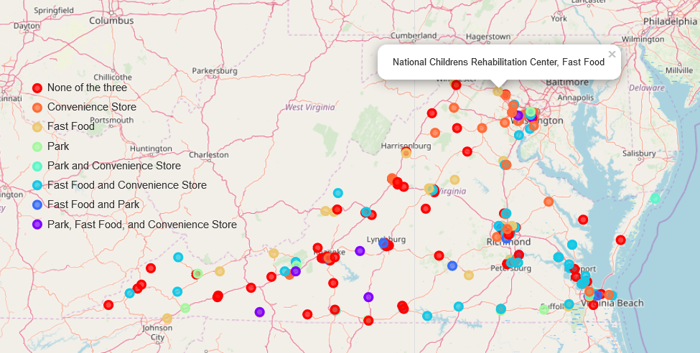
Results Plot - clusters based on presence of valued venue types
Notice that I can use the plot to quickly identify hospitals in Virginia that have or lack nearby venues that I value.

Slide 13
Discussion
The manually created clusters are much more useful than the ones generated by machine learning
These results, however fascinating, are limited in their accuracy and usefulness
This study does not take into account gift shops or floral shops, which may also be valued by hospital patrons
The results do not account for walking trails or garden paths around or near the hospitals, which may be more desirable, and likely more common, than parks
The results are only as accurate as the Foursquare data is complete and accurate
It is possible that while cleaning the data I removed venues that could have changed the results
This study could be revised to compare the venues surrounding other hospital types, such as psychiatric hospitals or nursing homes.
In case there is a subject matter expert out there, the algorithms used in this study could be adapted to finding more valuable venue types by changing the keyword searches and filters.
Happy hospital hopping!

